Slide 1
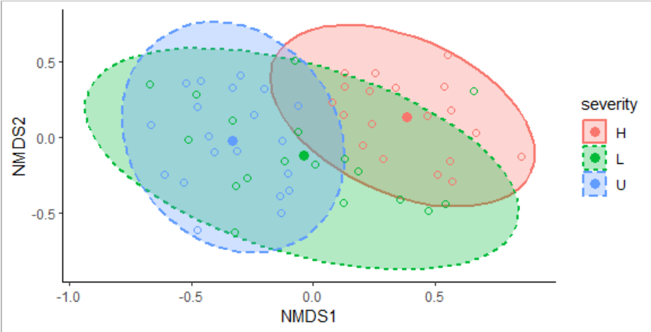
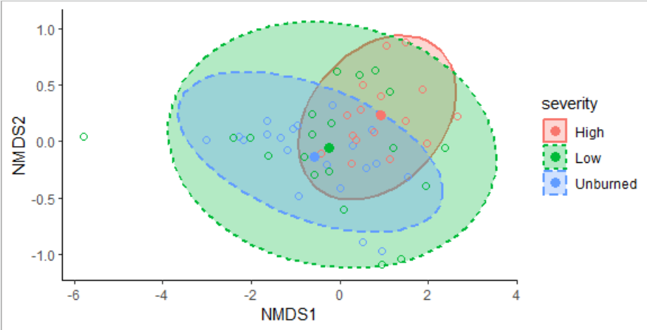
Seed mass and dispersal
Taxonomic
Functional

Slide 2
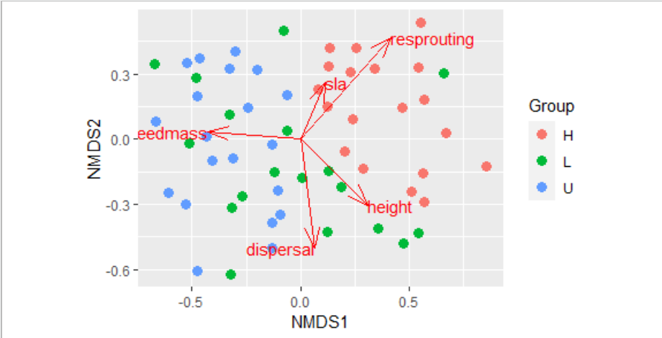
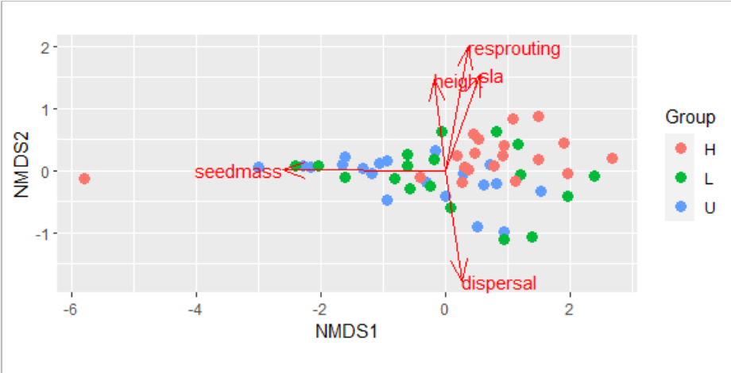
Seed mass and dispersal
Taxonomic
Functional

Slide 3
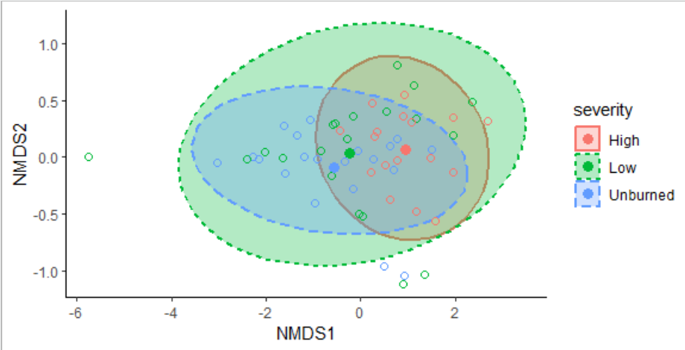
Seed mass only
Taxonomic
Functional

Slide 4
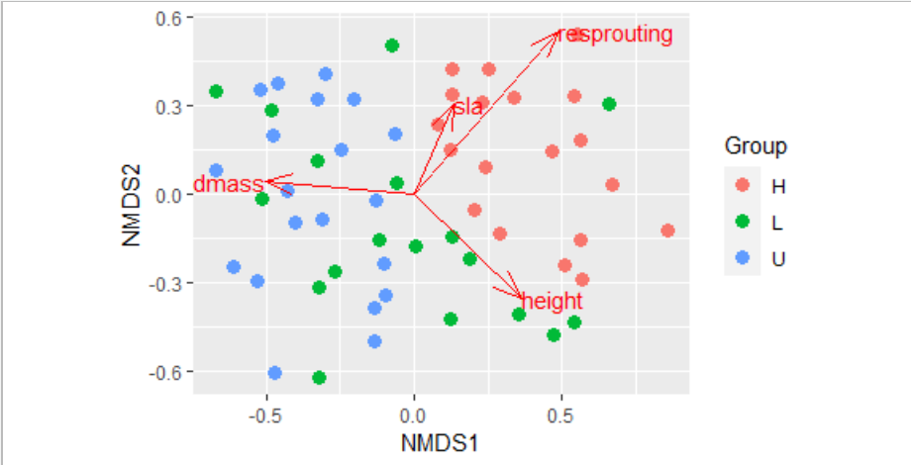
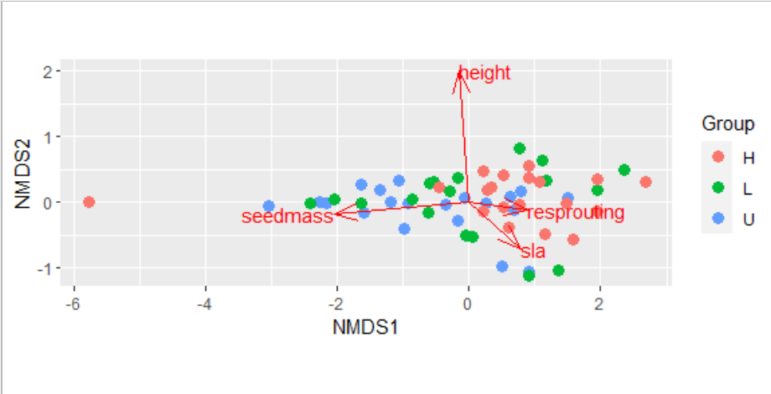
Seed mass only
Taxonomic
Functional

Slide 5
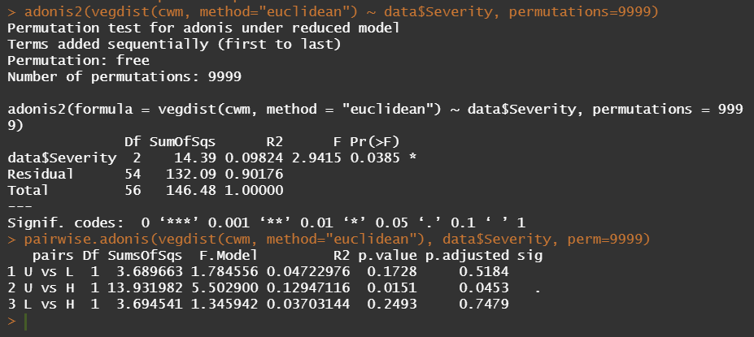
PERMANOVA (seed mass and dispersal)

Slide 6
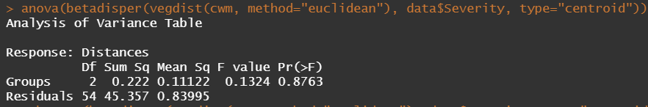
Beta dispersion (seed mass and dispersal)

Slide 7
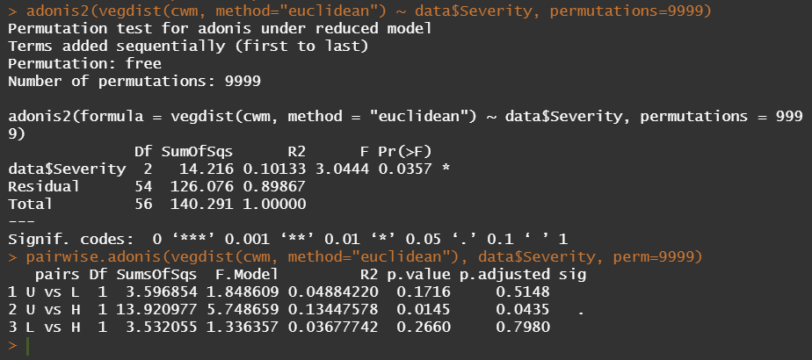
PERMANOVA (seed mass only)

Slide 8

Beta dispersion (seed mass only)

